Slide 1
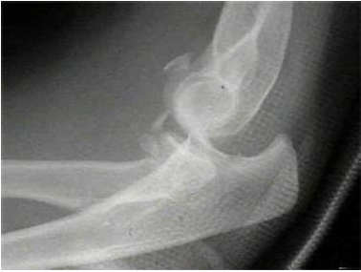
Terrible Triad - Elbow

Slide 2
Terrible=ترسناک،خوفناک،بسیار بد

Slide 3
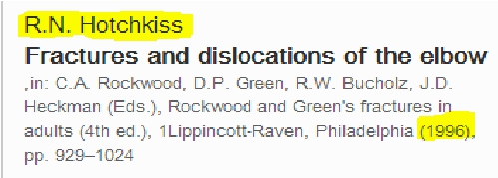
Terrible Triad
• Elbow dislocation
• Coronoid fracture
• Radial head fracture

Slide 4
The “terrible triad“
• Elbow dislocation
• Coronoid fracture
• Radial head fracture
• Primary and secondary stabilizers disrupted
• Recurrent instability the rule

Slide 5
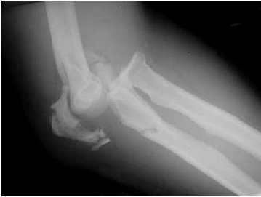
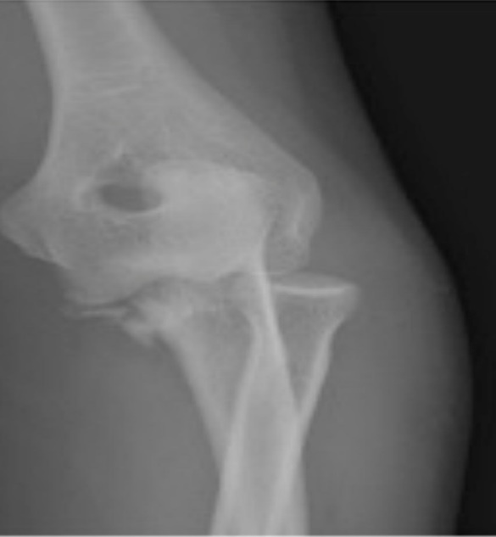
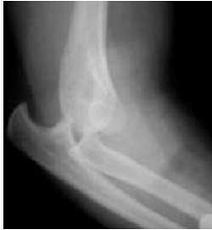
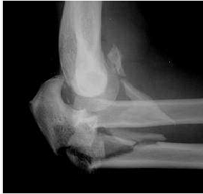
varus posteromedialv
Complex fracture dislocations
transolecranon fracture
dislocation
postromedial varus instability
dislocation, radial
head, coronoid
TERRIBLE
posterior Monteggia
TRIAD

Slide 6
Why terrible
• Recurrent / persistent subluxation or
dislocation
• Chronic instability
• Arthrosis and pain

Slide 7
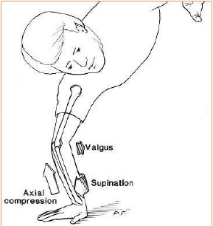
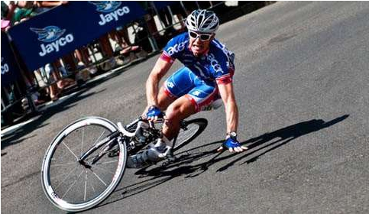
Mechanism of injury
• Fall on outstretched hand
• Axial load, supination & Valgus stress

Slide 8
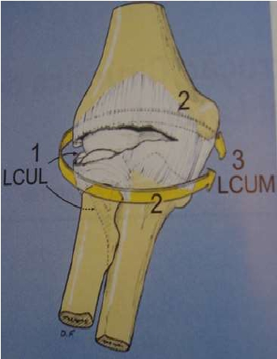
Stages
I Ulnar lateral collateral
ligament disruption
II Anterior and posterior
soft issue disruption with
coronoid under trochlea
III a Intact MCL anterior
band
III b Ruptured MCL anterior
band
III c All soft tissue stripped

Slide 9
Stabilizers of elbow
• Primary stabilizers
Ulnohumeral joint
MCL -( Ant. Bundle)
LCL -
• Secondary stabilizers
Radiohumeral joint
Capsule
Origin of flexor & extensor
Dynamic stabilizers - Muscle crossing elbow
Anconeus
Brachialis
Triceps

Slide 10
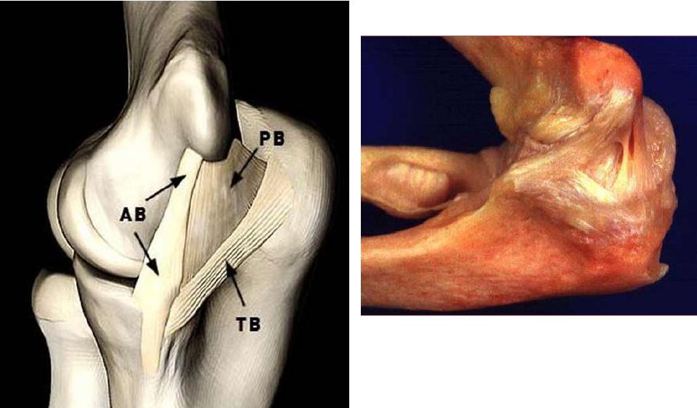

Slide 11
What are the Dilemna
• Surgical techniques challenging
• Debate in surgical steps
• Choices in management

Slide 12
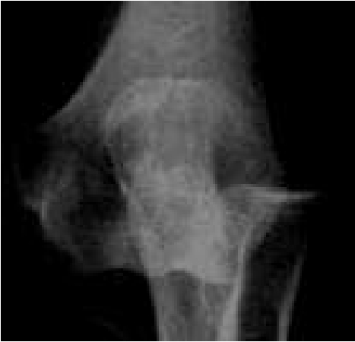
treatment goals
• Obtaining and
maintaining
a concentrically
reduced
articulation
• Early range of motion

Slide 13
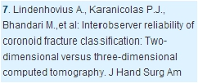
Imaging
• X- rays – Ap and lateral
• Ct scan – Include 3D reconstruction

Slide 14
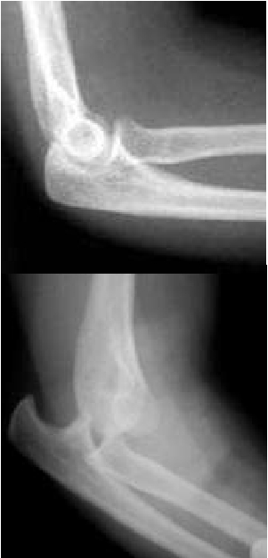
Management
• Dislocated elbow – reduce in emergency dept
• Unstable – Do not perform rpt rereduction
• Plan under anaesthesia

Slide 15
Non operative treatment
• Small coronoid and radial head fracture
• Concentrically reduced ulnohumeral and
radiocapitellar joint
• Ct scan – insignificant fracture
• Elbow unstable in only < 30 deg flexion
IMMOBILIZE IN 90 Deg
FLEXION

Slide 16
Surgical protocol
• Fixation / replacement radial head
• Fixation of coronoid fracture – if possible
• Repair of associated capsule and collateral
ligament
PUGH et al 2004
In recalcitrant cases
• Repair of MCL
• Adjuvant hinged fixator

Slide 17
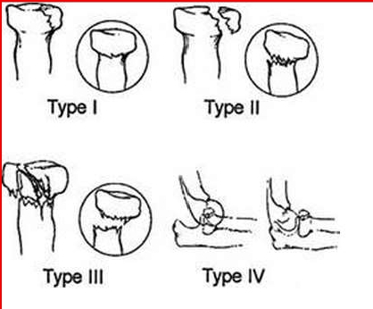
Radial Head Fractures:
Modified - Mason Classification
•Type I: nondisplaced
– No block to forearm rotation, displacement < 2mm
•Type II: displaced
– Internal fixation possible
•Type III: displaced, severely comminuted
– Judged to be irreparable
•Type IV: fracture + dislocation

Slide 18
Radial Head - ORIF
• One / Two part articular fracture
• Entire head – one piece
• Preserve head when possible

Slide 19
Do not excise without replacement
•
•
•
•
Restore radial head
If not possible replace
Repair lateral collateral lig
Orif of coronoid

Slide 20
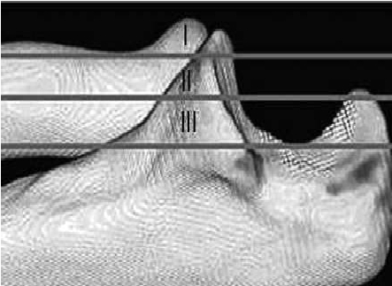
Coronoid Fracture – Regan & Moorey
Classification
• Type 1 - # tip
• Type 2 - < 50 %
• Type 3 - >50%

Slide 21
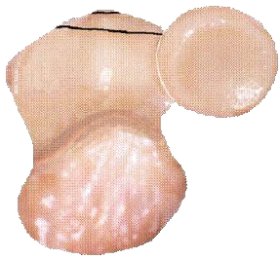
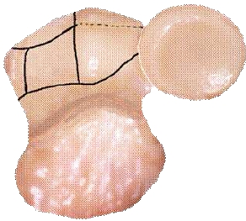
Classification: Coronoid fractures
•O’Driscoll Classification
•Type I:
•Type II:
•Type III:
tip
anteromedial facet
base

Slide 22
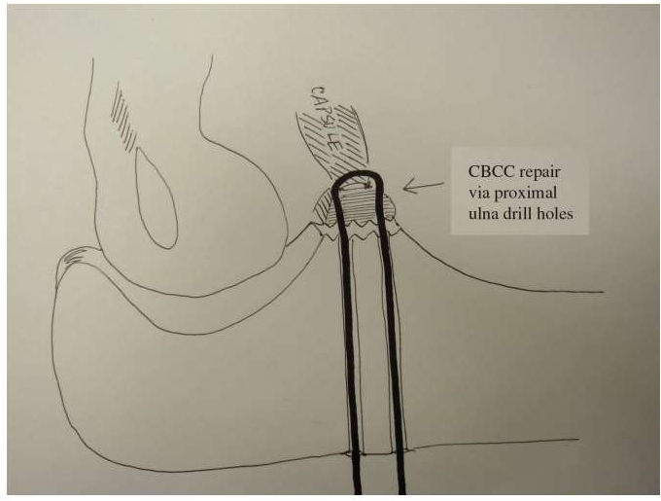
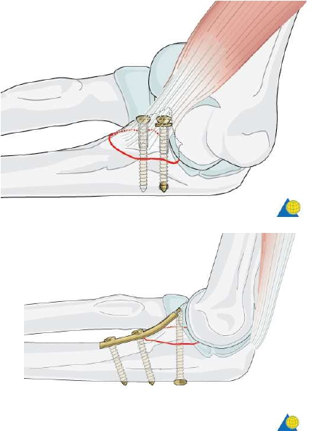

Slide 23
Approach
• lateral approach
• Medial and lateral approach

Slide 24
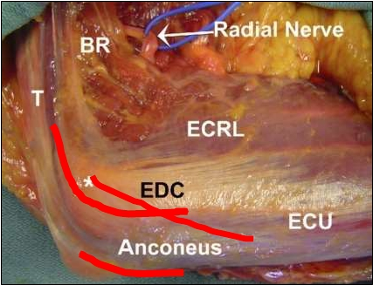
Lateral Interval
• Kocher ‘s - ECU and
anconeus
• Boyd’s - Ulna and
anconeus
• Kaplan- Extensor
elevated off the ridge
“ AVAILABLE
WINDOW”

Slide 25
Operative treatment
• Work on primarily lateral side
• Work from “outside” to “inside”
LCL / common extensor → Radial head fracture → Coronoid
fracture

Slide 26
Operative treatment
• Stabilize in reverse order
“inside” to “outside’’
• Repair coronoid → Repair / replace radial
head → reattach common extensor/LCL

Slide 27
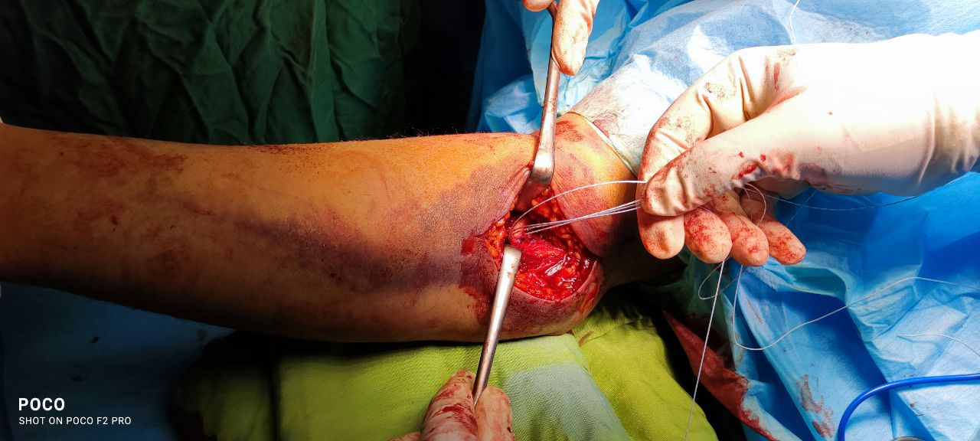

Slide 31
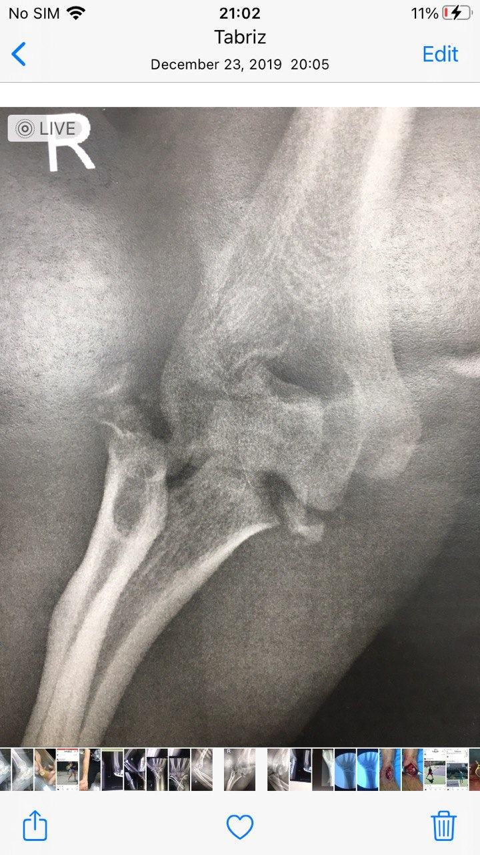
35years old man with falling

Slide 35
Medial Collateral ligament
• After repairing radial head
• Coronoid
• LCL
• Test elbow stability – Fluoroscopically
• Elbow unstable from 30 to 130 – repair MCL

Slide 36
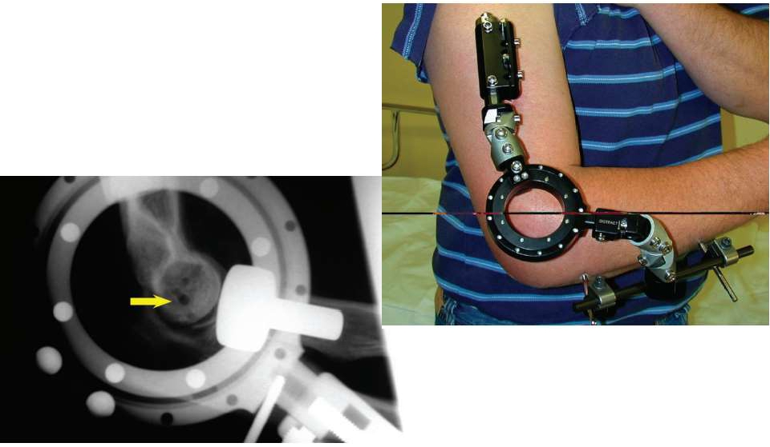

Slide 37
Post op Rehabiliattion
• Begin Range of motion - 2 – 5 days
• Stable arc of motion – intraop determined
• Resting splint – 6 weeks
• Night splint - 12 weeks

Slide 38
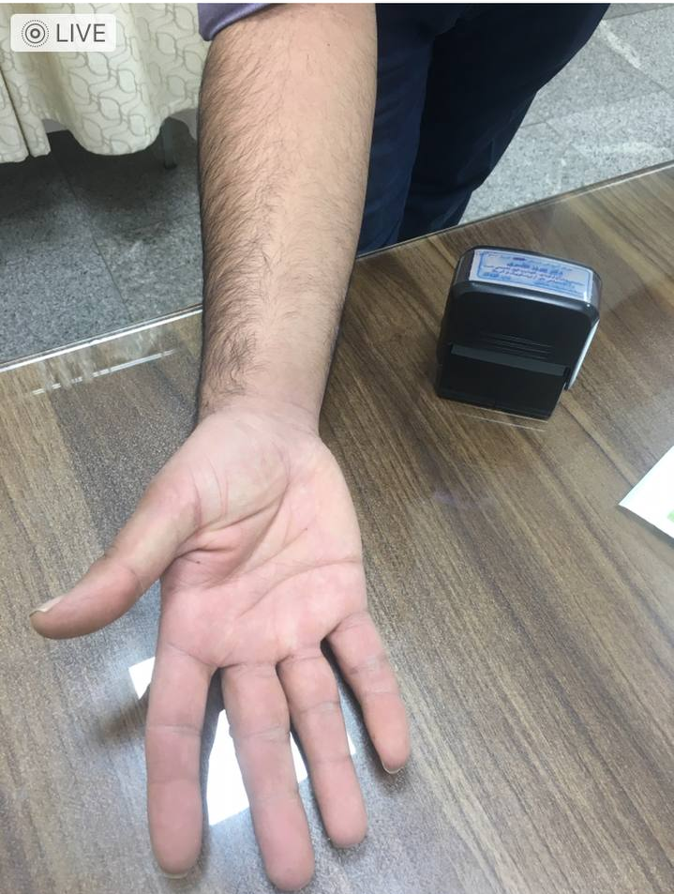
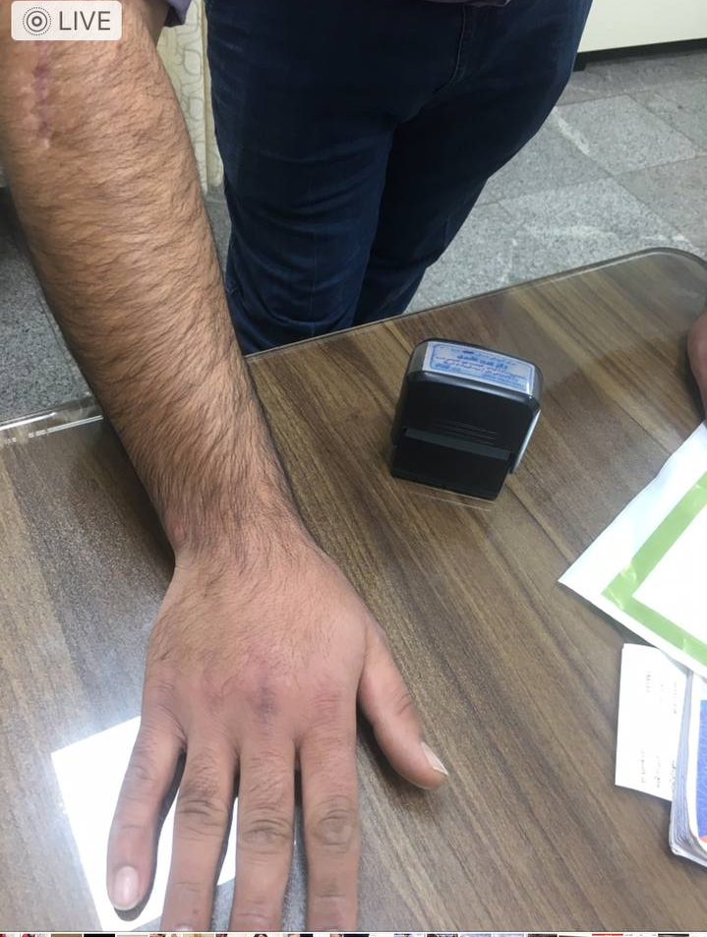

Slide 39
Complications
• Instability
• Failure of internal fixation
• Post traumatic stiffness
• Heterotopic ossification
• Post traumatic arthritis

Slide 40
Good stability and early ROM

Slide 41
Thank you

